Slide 1
COMPLAINT
MANAGEMENT
SYSTEM
PRESENTED BY:
Pratyaksh Rawat , Priyanshu Singh ,
Ritik Bhardwaj , Arjun Verma
Project Guidance :
GUIDED BY:Mr. Hitesh Sharma (Major Project Supervisor)

Slide 2
INTRODUCTION
Purpose :
To digitize the entire lifecycle of a complaint—from lodging a ticket to final resolution—ensuring total transparency and efficiency.
Project Overview :
A web-based application designed to bridge the communication gap between users and administrators for reporting and resolving grievances.
Domain :
Full-Stack Web Development. Combining modern frontend interfaces with a robust backend for seamless data flow.
Key Features :
Features include secure role-based login, automated status tracking (Pending/Resolved), and a centralized admin dashboard.

Slide 3
PROBLEM STATEMENT
Slow Resolution
Communication between departments is slow, leading to long delays in fixing simple campus issues.
Manual Inefficiency
Lack of Transparency
Traditional complaint filing relies on physical registers, which are prone to being lost, damaged, or misplaced.
There is no way for a user to know if their complaint has been seen, assigned, or resolved in the current manual system.
Data Vulnerability
No backup of records exists, making it impossible to generate monthly analysis reports for college management.

Slide 4
OBJECTIVES
User-Centric Goals
Technical Goals
Transparency: To provide users with real-time tracking of their grievance status (Pending to Resolved).
Efficiency: To bridge the communication gap between students and management for faster response times.
Automation: To digitize the manual complaint registration process, eliminating paperwork and human error.
Data Centralization: To maintain a secure, organized MySQL database for all institutional records and history.

Slide 5
EXISTING SYSTEM & LIMITATIONS
The current manual grievance process is built on a legacy paper-based framework that suffers from several critical bottlenecks and inefficiencies such as :-
Slow Communication
Manual Recording
Lack of Tracking
Information travels via paper slips between departments, causing massive delays in resolving issues.
No live updates. Users must physically visit offices to check the current status of their complaints..
Reliance on physical registers leads to slow entry, messy organization, and frequent human errors.

Slide 6

PROPOSED SYSTEM
A robust, web-based automated system designed to centralize grievance handling and ensure 100% transparency.
Real-Time Tracking
Faster Fixes
Automates the routing of complaints to the right department, cutting down resolution time by 70%.
Students can track their grievances in real-time—from "Pending" to "Resolved"—on their own dashboard.
Digital Transformation
Replaces messy paperwork with a secure digital system for instant data retrieval and zero loss.
Enhanced Security
Protects information using role-based logins, ensuring that only authorized admins can access or change records.

Slide 7
TECHNICAL STACK
Technologies: HTML5, CSS3, JavaScript
Purpose: To create a responsive and user-friendly interface.
1.Frontend (UI)
Language: Python
Framework: Django (or Flask)
Use: Handling logic, user authentication, and data routing.
2.Backend (Server)
Heading: Data Storage
Technology: MySQL (or PostgreSQL)
Use: Managing secure records for complaints, users, and admin data.
3.Database
IDE: VS Code
Tools: Pip (Package Manager), Python VirtualEnv
Use: Managing project dependencies and local server testing.
4.Development Tools

Slide 8
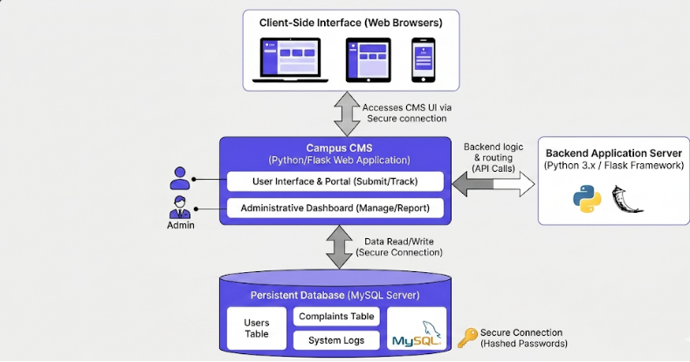
System Architecture
A high-level overview showing the seamless interaction between the Web Interface, the Python Backend, and the MySQL Database

Slide 9
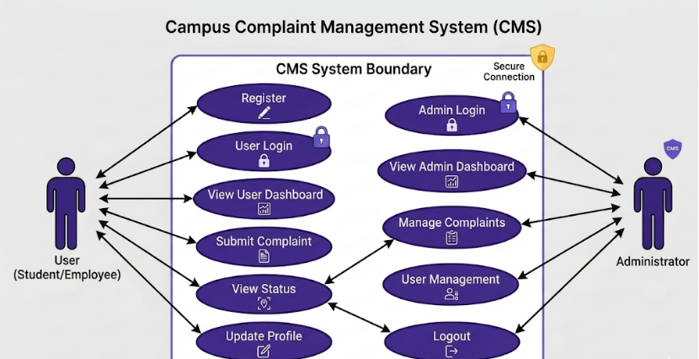
Use Case Diagram
Defines the functional requirements of the system by mapping the specific actions available to both Users and Administrators

Slide 10
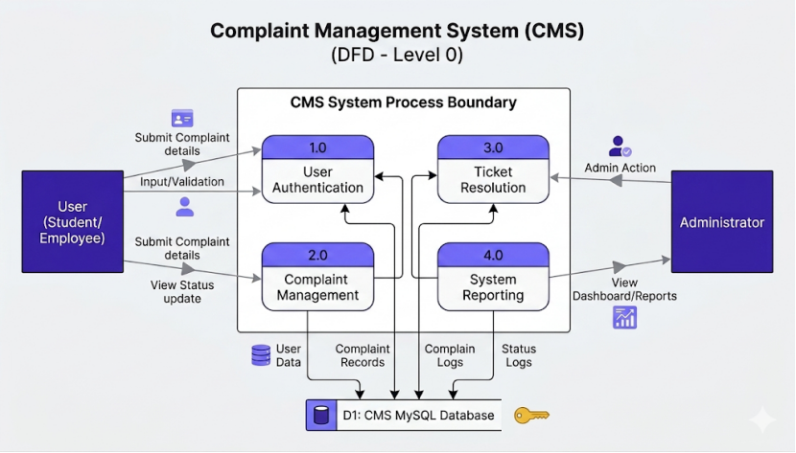
Data Flow Diagram
Illustrates the flow of information between the User, the Admin, and the Database through key processes like Authentication and Complaint Management.

Slide 11
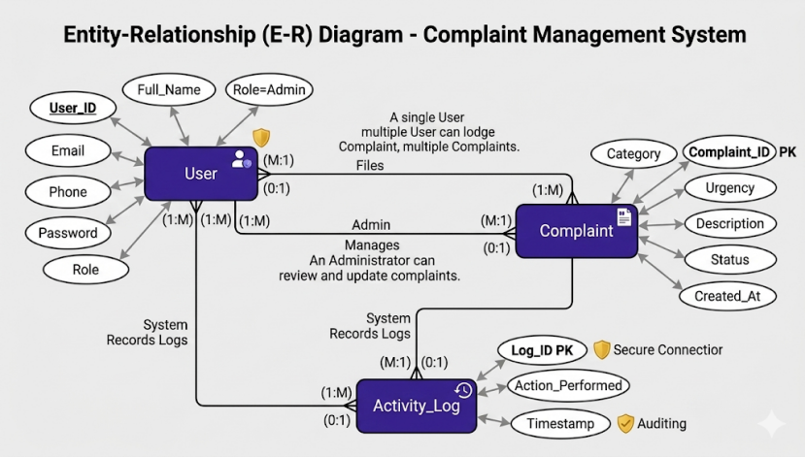
Database Design
Displays the database structure and relationships between Users, Complaints, and System Activity Logs.

Slide 12
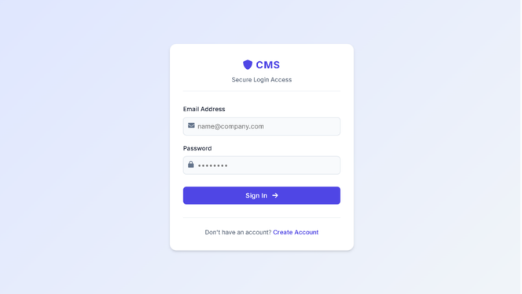
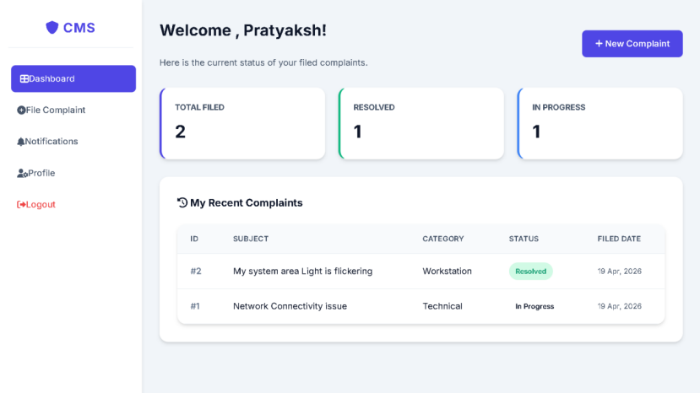
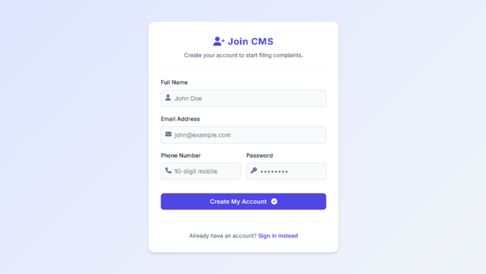
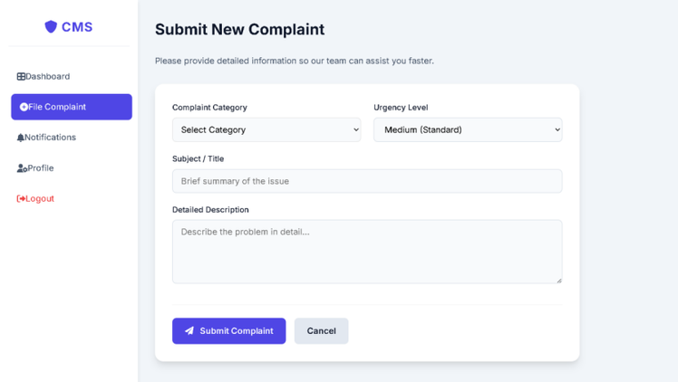
Implementation / Screenshots
User Dashboard & Status Overview
Login Portal
Complaint Submission Interface
User Registration

Slide 13
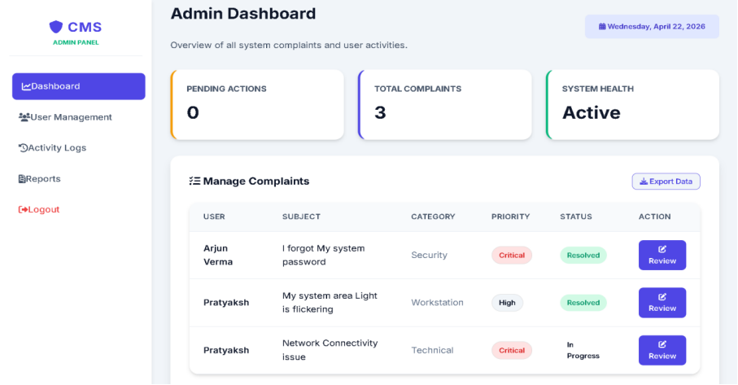
Implementation / Screenshots

